Slide 1
Bioinformatics Building Phylogenetic Trees
Assoc. Prof. Dr. Gazi Erkan BOSTANCI
Slides are mainly based on ‘Understanding Bioinformatics’ by Marketa Zvelebil and Jeremy O. Baum

Slide 2
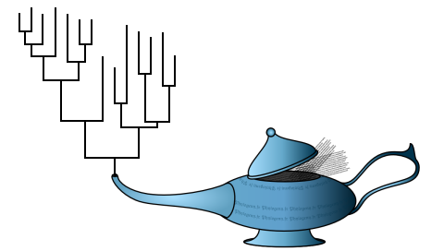
Evolutionary Models and the Calculation of Evolutionary Distance
Analysis of reliable sequence alignments has revealed some general rules governing the ways in which mutation leads to changes in DNA sequences over time.
These observations have been incorporated into models of molecular evolution, which are used in all methods of tree-building.
Our focus in this lecture will be on DNA rather than protein sequences, and most of the models of mutation and evolution discussed here will refer to nucleotide sequences.

Slide 3
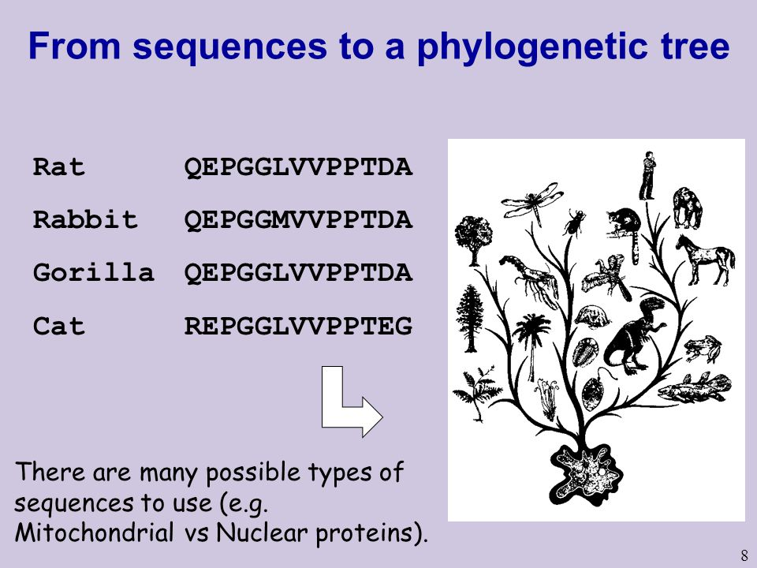
Some features of nucleotide sequence evolution can easily be included in very simple models.
Others have proved much more difficult to incorporate in a practical way, and are frequently ignored.
After describing some simple models in common current use, we will briefly discuss a few features that are at present usually not modeled properly.

Slide 4
A simple but inaccurate measure of evolutionary distance is the p-distance
The evolutionary distance between two sequences is an estimate of the number of mutations that has occurred since those sequences diverged from their common ancestor.
The simplest, if unrealistic, measure of evolutionary distance is the fractional alignment difference; that is, the observe fraction of sites in two aligned sequences that have different bases. If an alignment of two sequences has L positions (without counting positions at which one sequence has a gap), of which D differ, then the fractional alignment difference, usually called the p-distance, is defined as
* Note that we can also use the number of differences in the alignment as the distance measure, fractional alignment difference described here is a normalized version of the same measure.

Slide 5
This measure is usually too inaccurate for serious work:
For low rates of mutation and/or short evolutionary times, very few sequence differences are observed. Thus, for the relatively short sequence lengths that are often used to reconstruct phylogeny there is considerable statistical variation between sequences, leading to potentially large errors in p-distance estimates.
Much more frequently encountered is the case that at longer evolutionary times, many sites have undergone mutation more than once. Observed differences are thus an underestimate of the total number of mutations that have occurred over that time, and it is the total number we are interested in for phylogenetic tree construction.
Finally, not all species evolve at the same rate, and neither do all genes in the same species, because they are under different evolutionary pressures at different times. There may be fortuitous averaging out for sufficiently long times but this is by no means always the case. To take account of these sources of error in the p-distance, the evolutionary distance measure needs to be modified by the application of a more sophisticated evolutionary model.

Slide 6
There are also other types of distances:
The Poisson distance correction takes account of multiple mutations at the same site.
The Gamma distance correction takes account of mutation rate variation at different sequence positions.

Slide 7
Generating Single Phylogenetic Trees
There are two main classes of techniques for reconstructing phylogenetic trees.
Clustering methods gradually build up the tree, starting from a small number of sequences and adding one sequence at each step. The output from these methods is a single tree that attempts to recover the evolutionary relationships between the sequences.
In the second group of methods, many different tree topologies are generated and each is tested against the data in a search for those that are optimal or close to optimal according to particular criteria.

Slide 8
The UPGMA method assumes a constant molecular clock and produces an ultrametric tree
The first distance method we will look at—UPGMA—is simple to apply, but has the disadvantage that it assumes a constant molecular clock. This method is one of the oldest, having been devised by Robert Sokal and Charles Michener in 1958. The name UPGMA is an acronym of Unweighted Pair-Group Method using arithmetic Averages, a description of the technique used.
Assumption of a constant rate of evolution has important consequences for a dataset of sequences that are all associated with the same evolutionary time point, namely the present day, as it dictates that the same number of substitutions will have occurred in each sequence since the time of the last common ancestor. Thus, the distance from any node to any leaf that is its descendant will be the same for all descendants.
The trees produced by this method are rooted and ultrametric, and all the leaves are at the same distance from the root.

Slide 9
The two sequences with the shortest evolutionary distance between them are assumed to have been the last to diverge, and must therefore have arisen from the most recent internal node in the tree.
Furthermore, their branches must be of equal length, and so must be half their distance. This is how the construction of the tree is started. The method must recover all the internal nodes in the tree and at each step another internal node is recovered.
The sequences are grouped into clusters as the tree is constructed, each cluster being defined as the set of all descendants of the new node just added. Initially, all sequences are regarded as defining their own cluster.
At each stage, the two clusters with the shortest evolutionary distance are combined into a new cluster. The tree is complete when all the sequences belong to the same cluster, whose node is the root of the tree.

Slide 10
The distance between two clusters is defined as follows. Consider the construction of a tree for N sequences and suppose that at some stage you have clusters X containing N_{X} sequences and Y containing N_{Y} sequences. Initially, each cluster will contain just one sequence. The evolutionary distance (d_{XY}) between the two clusters X and Y is defined as the arithmetic average of the distances between their constituent sequences, that is
where i labels all sequences in cluster X, j labels all sequences in cluster Y, and d_{ij} is the distance between sequences i and j. When two clusters X and Y are combined to make a new cluster Z there is an efficient way of calculating the distances of other clusters such as W to the new cluster.

Slide 11
The new distances can all be defined using existing cluster-to-cluster distances without the need to use the constituent sequence-to-sequence distances, using the equation
This method is very straightforward to apply, and can be used to construct trees for large sets of sequences.
The method is illustrated in Figure below for six sequences. In the first step, sequences A and D are found to be the closest (d_{AD} = 1) and are combined, creating cluster (and node) V at a height of 1/2(= d_{AD}/2) , see Figure (A).
Following calculation of the distances of V from the other sequences, the closest pair is E and V, which are combined into cluster W at a height of 1 (= d_{EW}/2), see Figure (B). Continuing in this way, the final tree is obtained.

Slide 13
If the data being analyzed did not evolve under conditions of a molecular clock, however, the tree produced by UPGMA could be seriously in error.
A dataset can, however, be tested beforehand for likely compatibility with the method.
For an ultrametric tree to be appropriate for the dataset, for all sets of three sequences A, B, and C, the three distances d_{AB}, d_{AC}, and d_{BC} should either all be equal or two should be equal and the third distance be the shortest. This is the case for the example dataset.

Slide 14
The Fitch–Margoliash method produces an unrooted additive tree
We shall now look at another methods that do not make the assumption of constant mutation rate, but do assume that the distances are additive. The Fitch–Margoliash method is based on analysis of a three-leaf tree as shown in Figure below. The distances d_{ij} between leaves A, B, and C are trivially given in terms of the branch lengths by the formulae

Slide 15
The small tree from which the
Fitch–Margoliash method equations are derived.
The leaves A, B, and C are all connected to the same internal node by the branches b₁, b₂, and b₃.
The same formulae apply when there are other internal nodes of the tree on the paths between the three leaves and the common internal node, so long as the b_{i} are interpreted as the sum of all path branch lengths.

Slide 16
This means the tree is being treated as additive. We can readily derive formulae for the branch lengths in terms of the distances
which are estimates of the branch lengths based solely on the evolutionary distances.

Slide 17
Trees with more than three leaves can be generated in a stepwise fashion similar to that used by the UPGMA method. At every stage three clusters are defined, with all sequences belonging to one of the clusters.
The distance between clusters is defined (as in UPGMA) by a simple arithmetic average of the distances between sequences in the different clusters. At the start of each step we have a list of sequences not yet part of the growing tree and of clusters representing each part (if there is more than one) of the growing tree.
The distances between all these sequences and clusters are calculated, and the two most closely related (those with the shortest distance) are selected as the first two clusters of a three-leaf tree.

Slide 18
A third cluster is defined that contains the remainder of the sequences, and the distances to the other two are calculated. Using the above equations one can then determine the branch lengths from this third cluster to the other two clusters and the location of the internal node that connects them (see Figure above). These two clusters are then combined into a single cluster with distances to other sequences again defined by simple averages.
There is now one less sequence (cluster) to incorporate into the growing tree. By repetition of such steps this technique is able to generate a single tree in a similar manner to UPGMA.
Because the method of selecting closest cluster pairs is identical to that used in UPGMA, the tree topology produced from a set of data is the same for both methods.
The differences in the trees produced are the branch lengths and that the UPGMA tree is ultrametric whereas the Fitch–Margoliash tree is additive.

Slide 19
A worked example of the Fitch–Margoliash method is shown in Figure below, which also illustrates the minor extra complication involved in finding branch lengths between internal nodes.
This example also illustrates a weakness of the method in using the evolutionary distances directly to select nearest neighbors. If there are very different evolutionary rates along different tree branches the two closest sequences as measured by evolutionary distance may not really be neighbors.
In this case it leads to a negative branch length. The true evolutionary history cannot give rise to a tree with negative branch lengths, so this is clearly an error of the method.
In addition, the tree produced does not exactly reproduce the distances between sequences. There are many occasions when the rate variation is not so great as to produce these effects, in which case the method is capable of reconstructing the correct tree.

Slide 20
A worked example of the Fitch–Margoliash method reconstruction of a phylogenetic tree for five sequences (N = 5). At each step the three-leaf tree that is the equivalent of Figure above is shown in red on the left-hand tree.
(A) In the first step the shortest distance is used to identify the two clusters (A, C) which are combined to create the next internal node. A temporary cluster W is defined as all clusters except these two, and the distances calculated from W to both A and C.
The method then uses equations above to calculate the branch lengths from A and C to the internal node that connects them.
(B) In the second step, A and C are combined into the cluster X and the distances calculated from the other clusters. After identifying B and X as the next clusters to be combined to create cluster Z, the temporary cluster Y contains all other sequences. X is a distance b₃ from the new internal node, and the distance between the internal nodes is b₄. Branch length b₄ is calculated to be negative, which is clearly not realistic. However, in the further calculations this branch is treated like all the others.

Slide 21
(C) Combining sequences A, B, and C into cluster Z, the sequences D and E are added to the tree in the final step.
(D) The final tree has a negative branch length, and also does not agree with all the original distance data. The tables list the patristic distances D_{ij}—the distances measured on the tree itself—and the errors e_{ij}.

